Slide 1
Eye Tracking for Reading Assistance
Ashkan Bozorgzad, Kyle Diederich, Suhas Kumar, Ziqi Su

Slide 2
Problem Formulation
Large goal: Track eye movement to support reading
Part One: Track word by word movements of eyes along sentences
Part Two: Eye movement highlights and speaks words of page
State the problem and what kind of solution we are working towards
Su(story) – Suhas(tracker)

Slide 3

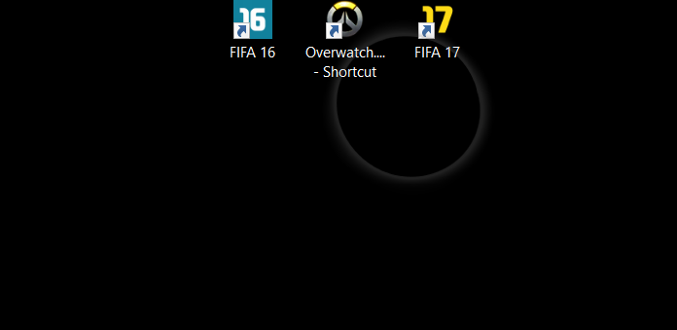

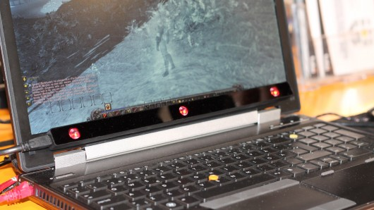
Problem Formulation
Detecting eyes during setup
Aim - Render Voice
Pros Cons
- Accuracy – OK - Detail Accuracy
- Speed - Miss
- Gaze Trace options - Eyes Pain
Touch at gaze - Mounted
Scroll at gaze
Mouse wrap on move
Application switching
Detection of eyes during Gaze Trace
Tobii eye X Tracker

Slide 4
Technical Challenges
Accuracy
Individual differences between eyes
What works for one set does not always transfer
Arc degree coverage (want a static user)
Dealing with dynamic positioning of user
Constant connection between eye and sensors
Problems with unspecific target goal
Ease of setup / portability
Hidden mounting requirement
Write our own software to obtain data from eye tracker
Account for rapid, random eye movements
Ashkan - Kyle

Slide 5
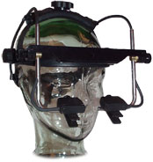
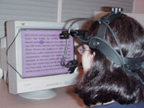
Approach
EyeLink Headband
Mounted to head
Cameras hang below eyes
Overhead camera tracking head position
Only track dominate eye position
Calibration period difficult (unclear of what changes to calibration allowed for greater success)
Currently minimal exploration of text
Capture infrared light reflections on both cornea and retina
Saccades and fixations
Develop a grid based on calibration
Change stimulus based on where eye is looking
Create boundaries to compensate for over/undershooting targets
Notes:
Saccades: rapid ballistic movements that bring the line of gaze from one place to another, are the primary means of acquiring new visual information
Fixations: the eyes stay relatively still to allow for visual perception
Change stimulus helps attract fixation – determine good length of fixation

Slide 6
Experiments
Experiment 1
Eye movement through a piece of text
Experiment 2
What granularity we can expect from eye movement data
Experiment 3
Does tracking follow the flow of your actual reading
Su

Slide 7
Demo
Best Case
Set up a profile and allow person to look through a piece of text where the eye movements are tracked accurately
Suhas

Slide 8
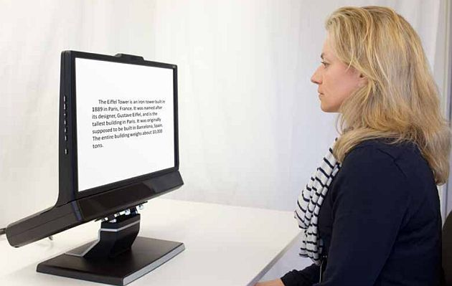
Demo
Eye Tracker is mounted to a laptop and a person is made to sit in front of laptop.
Person is made to see a sentence.
Eye movements are tracked accurately.
Render the voice of the words as the person scans the sentence.

Slide 9
Milestones
By end of October
Something
By end of November
Something
By end of first week in December
Done
Ashkan

